Slide 1
Libraries
Module E
Libraries
Input and Validations
Notes:
Prepared by Thân Văn Sử

Slide 2
Introduction
Many basic tasks are very hard for programming beginners.
The standard C libraries include functions to perform mathematical calculations, character analysis and character manipulation…
Library header files have the extension .h
Library binary files are implemented in files with specific filenames which are named by designers of tool suppliers (you may not know their names) and they are linked to your programs when they are compiled.
Lib.h
include
File.c
compile
File.obj
link
File.exe
Library binary code
Steps for creating a program

Slide 3
Objectives
After studying this chapter, you should be able to use the following build-in libraries:
Standard (stdib.h)
Time (time.h)
Math (math.h)
Character (ctype.h)

Slide 4
Content
The standard C libraries
Standard
Time
Math
Character

Slide 5
1- The Standard library: Stdlib.h
You can open this file using WordPad to get more information.
Common used functions
int abs(int) long labs(long) : Get absolute value of integral number
int rand(void), int srand(unsigned int seed): Get a random integer in [0.. RAND_MAX] In DevC++ (RAND_MAX=0x7FFF), start up the soft random mechanism
Functions for dynamic memory allocating: They are presented in the previous lecture
void exit(int code): Force the program terminating
int system ( const char* programName): Request a program to execute
char* itoa (int num, char* result, int base) char* ltoa (long num, char* result, int base) Convert integral number to ASCII string
int atoi (const char*) long atol (const char*) double atof (const char*) Convert an ASCII string to number
Notes:
Trong CPU có cài đặt sẵn cách tạo số ngẫu nhiên bằng phần cứng (hàm rand()). Như thế, bộ số ngẫu nhiên giống nhau cho mỗi lần gọi hàm.
Để tạo số ngẫu nhiên khác nhau cho mỗi lần chạy chương trình, ta dùng hàm srand(curTime) với curTime là số mili giây của đồng hồ máy tính hiện hành. Mỗi lần chạy khác nhau số mili giây khác nhau nên bộ số ngẫu nhiên sẽ khác nhau.

Slide 6
Stdlib.h…
Hardware randomize: this mechanism is supported by the hardware → Random sequence is the same in each time it performs.
Software randomize: A mechanism for generating a sequence of random number based on a mathematic algorithm using a initial number –seed (trị mầm) (It is presented in the subject Discrete Mathematics). So, the random sequence is different in each time it performs.

Slide 7
Stdlib.h…
/* stdlib_demo.c */
#include <stdio.h>
#include <stdlib.h>
#include <time.h>
int main()
{ int i; int a=5, b=50;
double x=3.5, y= 20.8;
printf("10 Hardware random integers:\n");
for (i=0;i<10; i++) printf("%d ", rand());
/*Init randomise using system time-miliseconds
Each time the program executes, the system time changes.
So, random sequence changes
*/
srand(time(NULL));
printf("\n\n10 Software random integers:\n");
for (i=0;i<10; i++) printf("%d ", rand());
printf("\n\n10 random integers between:%d...%d\n", a, b);
for (i=0;i<10; i++) printf("%d ", a + rand()% (b-a));
printf("\n\n5 random double between:%lf...%lf\n", x, y);
for (i=0;i<5; i++) printf("%lf ", x + (double)rand()/RAND_MAX*(y-x));
getchar();
}
Copy, paste, compile and run this program
y-x
0
x
y
0 <= value < 1

Slide 8
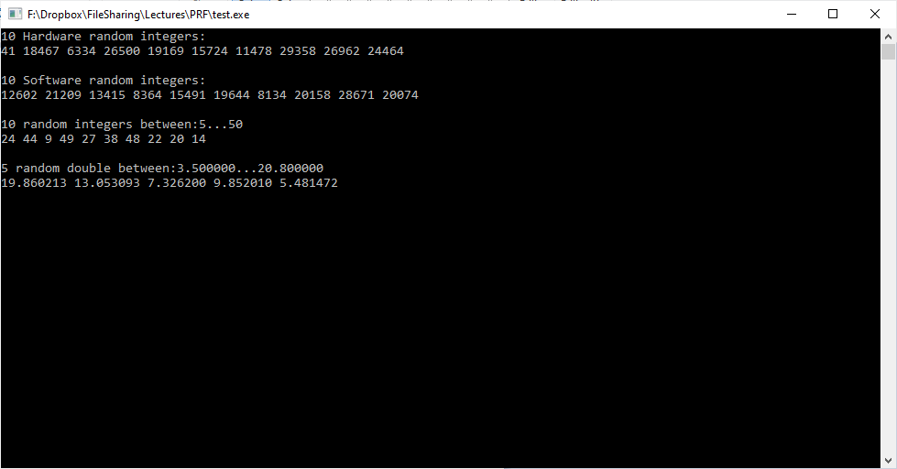
Result

Slide 9
2- The Time library: time.h
Some concepts
Date and time information is presented in computer using an integral number. It is usually the data type long.
A clock tick is the unit by which processor time is measured and is returned by 'clock'.
CLOCKS_PER_SEC: Number of clock ticks per second. A constant is defined in time.h (in Dev C++, CLOCKS_PER_SEC =1000 means that 1 clock tick = 1milisecond.
2 data type are defined in the library time.h:
  time_t : ( in DevC++: typedef long time_t;)
  clock_t : ( in DevC++: typedef long clock_t;)

Slide 10
The library time.h
Common used functions
time_t time ( time_t *tptr ); returns the current calendar time and this time is stored in it’s parameter.
double difftime ( time_t , time_t ); returns the difference in seconds between two calendar time arguments.
clock_t clock ( void ); returns the current date time information using the unit clock tick
We can use these function to evaluate time cost for an algorithm.

Slide 11
The library time.h
/* stdlib_demo.c */
/* Evaluate time cost of 1000000000 mathematic operations */
#include <stdio.h>
#include <time.h>
int main()
{ int i; int n=1; double x=1.5;
/* Use time_t data type */
time_t t1 = time(NULL); /*Get current time */ for (i=0; i<1000000000;i++) x= x+1;
time_t t2 = time(NULL); /*Get current time */
double dt = difftime(t2,t1);
printf("\nCost of 1 billion real number adding operations: %lf sec\n", dt);
t1 = time(NULL); /*Get current time */ for (i=0; i<1000000000;i++) n= n+1;
t2 = time(NULL); /*Get current time */ dt = difftime(t2,t1);
printf("\nCost of 1 billion integral number adding operations: %lf sec\n", dt);
/* Use clock_t data type */
n=1;
clock_t ct1= clock(); /*Get current time */ for (i=0; i<1000000000;i++) n= n+1;
clock_t ct2= clock(); /*Get current time */
printf("\nCost of 1 billion integral number adding operations: %ld ticks\n", ct2-ct1);
printf("\nor %lf secs\n", ((double)(ct2-ct1)/CLOCKS_PER_SEC));
getchar();
}
Copy, paste, compile and run this program

Slide 12
3- The Math Library: Math.h
It contains function prototypes for the mathematic functions
Constants:
#define M_E 2.7182818284590452354
#define M_LOG2E 1.4426950408889634074
#define M_LOG10E 0.43429448190325182765
#define M_LN2 0.69314718055994530942
#define M_LN10 2.30258509299404568402
#define M_PI 3.14159265358979323846
#define M_PI_2 1.57079632679489661923
#define M_PI_4 0.78539816339744830962
#define M_1_PI 0.31830988618379067154
#define M_2_PI 0.63661977236758134308
#define M_2_SQRTPI 1.12837916709551257390
#define M_SQRT2 1.41421356237309504880
#define M_SQRT1_2 0.70710678118654752440

Slide 13
The Math Library: Math.h…
Common used functions | Description | Example
double fabs(double) float fabsf(float) | Absolute
double floor ( double ); float floorf ( float ); |  | floor(16.3) → 16.0
double ceil ( double ); float ceilf ( float ); |  | ceil(16.3) → 17.0
double round ( double ); float roundf ( float ); |  | round(16.3) → 16.0 round(-16.5) → -17.0
double trunc ( double ); float truncf ( float ); long double truncl ( long double ); | truncate | trunc(16.7) → 16.0
double sqrt ( double ); float sqrtf ( float ); long double sqrtl ( long double ); | Square root

Slide 14
The Math Library: Math.h…
Common used functions | Description
double pow ( double base, double exponent ); float powf ( float base, float exponent ); long double powl ( long double base, long double exponent ); | Power base^{exponent}
double log ( double ); float logf ( float ); long double logl ( long double | Natural logarithm
double exp ( double x); float expf ( float ); long double expl ( long double ); | e^{x}
Trigonometric functions: | sin, cos, tan, asin, acos, atan

Slide 15
The Math Library: Math.h…
/* math_demo.c */
#include <stdio.h>
#include <time.h>
int main()
{ double x= 15.3, y=-2.6;
printf("floor: %lf, %lf\n", floor(x), floor(y));
printf("ceil: %lf, %lf\n", ceil(x), ceil(y));
printf("round: %lf, %lf\n", round(x), round(y));
printf("trunc: %lf, %lf\n", trunc(x), trunc(y));
printf("sqrt: %lf\n", sqrt(x));
printf("pow- x^y : %lf\n", pow(x,y));
printf("exp- e^x: %lf\n", exp(x));
printf("log(x): %lf\n", log(x));
printf("log2(x): %lf\n", log(x)/log(2));
getchar();
}
Copy, paste, compile and run this program

Slide 16
The Character Library: ctype.h
int isalnum (int c);
int isalpha (int c);
int iscntrl (int c);
int isdigit (int c);
int isgraph (int c);
int islower (int c);
int isprint (int c);
int ispunct (int c);
int isspace (int c);
int isupper (int c);
int isxdigit (int c);
int tolower (int c);
int toupper (int c);
alpha: alphabet
num: numeric/number
cntrl: control
print: printable
punct: punctuation characters (ký tự phân cách)
xdigit: hexadecimal digit
They are implemented using macro-definitions using the pre-processor #define

Slide 17
Summary
The standard C libraries
Standard: stdlib.h
Time: time.h
Math: math.h
Character: ctype.h
Q&A

Slide 18
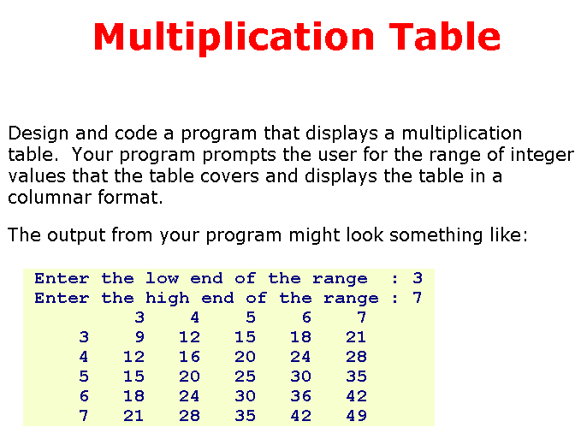
Practice
for (j=low to high)
for (i=low to high)
i*j

Slide 19
Input and validation
Formatted output

Slide 20
Contents
Types of Input
Input a character: getchar()
Input data: scanf(…)
Validation

Slide 21
Types of Input
Unbuffered Input
User
Device
Program
var
Buffered Input
User
Device
Device buffer
Program
var
Interactive program (event-based program) uses unbuffered input. The program can respond to each and every keystroke directly.
Buffer: A memory region is associated with a hardware such as keyboard, monitor, hard disk, … It holds data temporarily. Information about some buffers can be seen from MyComputer/ Properties/ Hardware/Device Manager/Select a device/Properties/Resources
Buffered input enables data editing before submission to a program. That means that input data can be treated as units and they can be pre-processed before they are passed to the program.
Input functions will access device buffer to get data.

Slide 22
Buffered Input
To transfer the contents of a buffer to a program the user must press the '\n' character.
Stream: A concept allows generalizing access data in a buffer as a chain of characters.
Two C functions provide buffered input facilities on the standard input stream:
  getchar() : get a character from the keyboard
  scanf (…) : get data from the keyboard

Slide 23

The getchar () function
getchar() retrieves a single character from the standard input stream buffer without translating the input. Prototype: int getchar(void );
getchar returns either the character code for the retrieved character or EOF.
(EOF=-1, ctrl+z in Windows, ctrl+d in Unix)
Copy. Paste, compile and run the program with input: Ctrl + Z
#include <stdio.h>
int main()
{ char c;
printf("Input a character:");
c = getchar();
printf("Code inputted:%d\n", c);
getchar();
}

Slide 24
getchar(): Clearing the buffer
When the buffer input is used, in some cases, you may not get successfully data for a variable because some characters are remained in the keyboard buffer. How to remove them?
/* clear empties input buffer */
void clear (void) {
  while ( getchar() != '\n' );
}
In some tools, the function fflush(stdin) is implemented for this purpose (in stdio.h).
To assure that a program always receives new character data. Make clear the keyboard buffer before the operation of accepting a character (or a string)

Slide 25

getchar()…
Copy, paste, compile and run the program:
#include <stdio.h>
int main()
{ char c1, c2;
printf("Input the 1st character:");
scanf("%c", &c1);
printf("Input the 2st character:");
c2 = getchar();
printf("c1=%c, ASCII:%d\n", c1, c1);
printf("c2=%c, ASCII:%d\n", c2, c2);
getchar();
}
Key
board
Buffer
A
01000001
Enter
00001101
00001010
c1
01000001
c2
00001010
The problem is that after user presses ‘A’ and ENTER (2 code: 13, 10), ASCII codes of them are put into the keyboard buffer. The function scanf(…) will get ‘A’ to c1. The remaining codes, 13 and 10, are interpreted to the character ‘\n’ – code 10 only, to c2 by the function getchar(). So, you can not get a new character for c2.

Slide 26
getchar()…
Copy, paste, compile and run the program:
#include <stdio.h>
#include <stdlib.h>
int main()
{ char c1, c2;
printf("Input a character:");
fflush(stdin);
c1= getchar();
printf("Input a character:");
fflush(stdin);
c2= getchar();
printf("c1: %c, ASCI code: %d, %o, %X\n", c1,c1,c1,c1);
printf("c2: %c, ASCI code: %d, %o, %X\n", c2,c2,c2,c2);
system("pause");
}
Data input are proposed:
A Z
The function system(“commandName”) , is prototyped in stdlib.h , allows calling a program stored in system file or an OS command.
Notes:
Hàm fflush(stdin) được dùng trước các átc vụ nhập ký tự/chuỗi để bào đảm nhấp ký tự/chuỗi thành công
Stdin – standard input

Slide 27
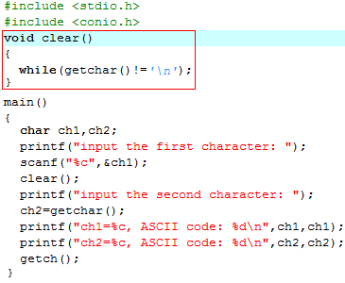

getchar()…
The user-defined function for clearing the keyboard buffer

Slide 28
getchar()…
Develop a program that will accept a string of characters until the key ENTER is pressed then number of digits, number of alphabets, and number of other characters are printed out.
Variable: char c;
int numOfDigits=0, numOfAlpha=0, numOfOthers = 0
Algorithm
While (c=getchar() != ‘\n’)
{ if c is a digit then numOfDigits++ ;
else if c is an alphabet then numOfAlpha++;
else numOfOthers++;
}
Print out numOfDigits;
Print out numOfDigits;
Print out numOfOthers;
Do yourself

Slide 29
The scanf(…) function
scanf retrieves data values from the standard input stream buffer under format control.
  scanf( format string, &identifier , ... )
scanf extracts data values from the standard input stream buffer until scanf has
  interpreted and processed the entire format string,
  found a character that does not meet the next conversion specification in the format string, in which case scanf leaves the offending (tội lỗi) character in the buffer, or emptied the buffer, in which case scanf waits until the user adds more data values.

Slide 30
The scanf(…) function…
Some things are concerned when the scanf(…) function is used:
  How to specify the input format string?
  How to separate input data?
  How to realize that how many data were inputted successfully?
  How to remove the byte ‘\n’ in the keyboard buffer after an input operation? Is clearing the buffer is the only way?
We will get the answers in the following slides.

Slide 31
scanf …: Conversion Specifiers
Specifier | Input value | Use with
%c %*c | character | char Remove one character in the input buffer
%d | decimal | char, int, short, long, long ong
%u | decimal | unsigned int, char, int, short, long, long long
%o | octal | unsigned int, char, int, short, long, long long
%x %X | hexadecimal | unsigned int, char, int, short, long, long long
%ld | long | long
%f | float | float
%lf | double | double
%llf | long double | long double
Data from the keyboard are passed to the buffer as characters (ASCII codes). So, conversion specifiers are instructions that specifying how to converse character data to typed-data. If a specifier does not match the data type of a variable, the conversion is incorrect.

Slide 32
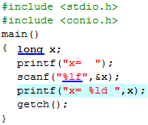
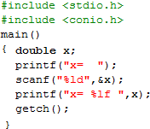


Conversion Specifiers…
The conversion specifier does not match the data type long
The conversion specifier does not match the data type double

Slide 33
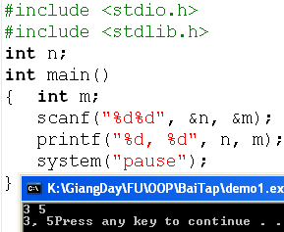
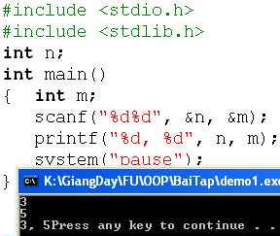
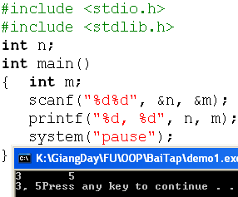
scanf…: Default Separators
If a input value is number lead by a whitespace , scanf treats the whitespace as a separator (The whitespace characters include newline, horizontal tab, form feed, vertical tab and space characters).
Space character
New line / Enter
Tab character
Notes:
W

Slide 34
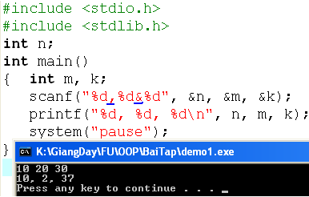
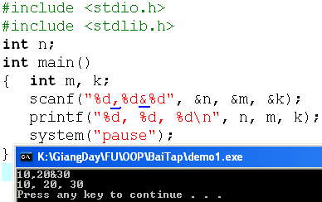
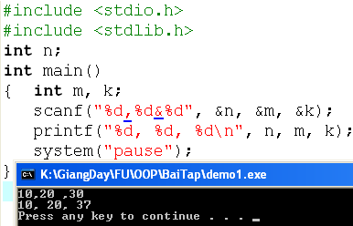
scanf…: User-Defined Separators
User can specify the character for separating input data.
User-define separators will override default separators
Notes:
W

Slide 35
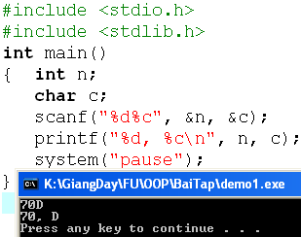
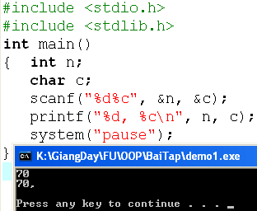
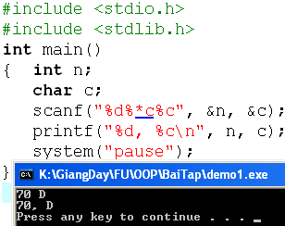
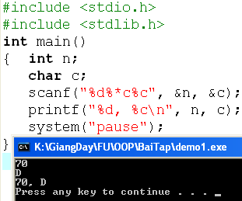
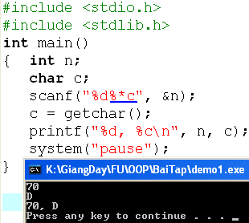
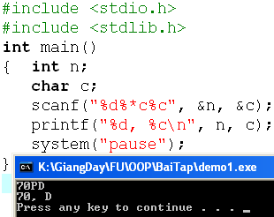
scanf(…): Using %*c for removing a character
Input: 70 ENTER
‘\n’

Slide 36
scanf…: Number of data fields are inputted
Return values from the scanf function:
  scanf returns the number of addresses successfully filled or EOF. A return value of
    0 indicates that scanf did not fill any address,
    1 indicates that scanf filled the first address successfully,
    2 indicates that scanf filled the first and second addresses successfully,
    ...
    EOF (-1) indicates that scanf did not fill any address AND encountered an end of data character.
The return code from scanf does not reflect success of %* conversions.

Slide 37
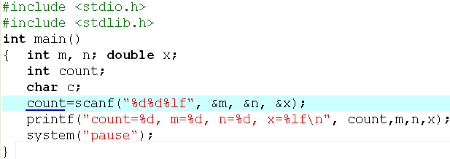





Number of data fields are inputted…

Slide 38
Input Validation
We cannot predict how the user will input the data values: whether the user will enter them as requested or not. One user may make a mistake. Another user may simply try to break the program.
The program should have code for trapping all erroneous input, which includes:
  invalid characters
  trailing characters
  out-of-range input
  incorrect number of input fields

Slide 39
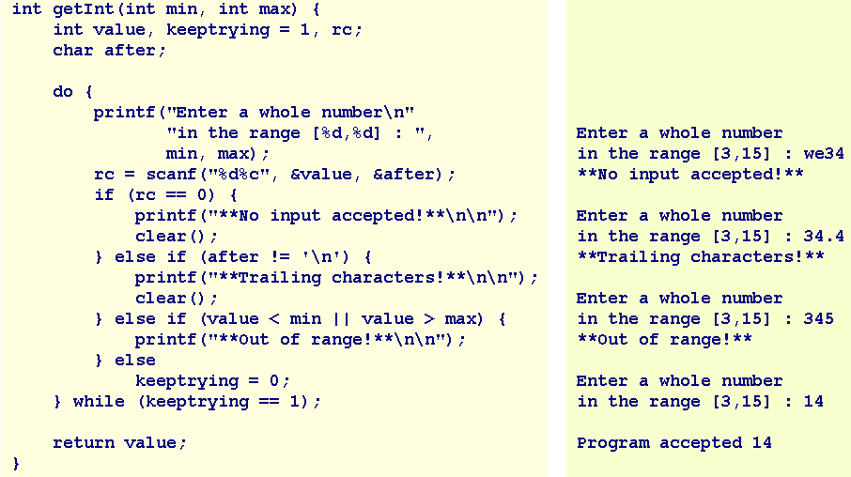
Input Validation: Example
The following function will ensure that inputted integer must be in the range [min,max] and no invalid characters or trailing character following inputted digits(EXCEPT the ENTER key)

Slide 40
In-Class Practice
Design and code a function named getDouble that receives two double values - a lower limit and an upper limit - and returns user input that lies between the limiting values. Your function rejects any input that includes trailing characters or lies outside the specified limits.

Slide 41
Summary
Input and Validation
Types of Input
getchar
scanf
Input validation
Q&A
EoS15

Slide 42
Formatted Output
Standard output is buffered. The standard output buffer empties to the standard output device whenever the buffer receives a newline character or the buffer is full.
Buffering enables a program to continue executing without waiting for the output device to finish displaying the most recently received characters.
The library stdio.h containing functions for print out data:
  putchar(int) : character
  printf ( format_string, varList): list of data

Slide 43
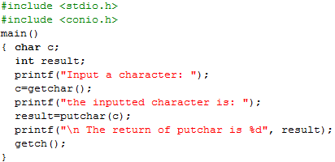


The function putchar(int)
putchar writes the character received to the standard output stream buffer and returns the character written or EOF if an error occurred.
Prototype: int putchar ( int );
For example: putchar('a');

Slide 44
The function printf(…)
printf sends data under format control to the standard output stream buffer and returns the number of characters sent.
Syntax: printf ( format string , value, ..., value )
The format string is a literal string that consists of characters interspersed (đặt rải rác) with conversion specifiers.
Conversion specifier begins with a % and ends with a conversion character

Slide 45
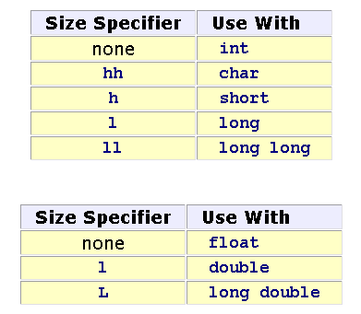
printf(…): Format string
Between the % and the conversion character, there may be
% flags width . precision size conversion_character
flags
  - prescribes left justification of the converted value in its field
  0 pads the field width with leading zeros
size identifies the size of data type of the value passed.
Notes:
Prescribes: ra lenh
Justification: chung minh

Slide 46
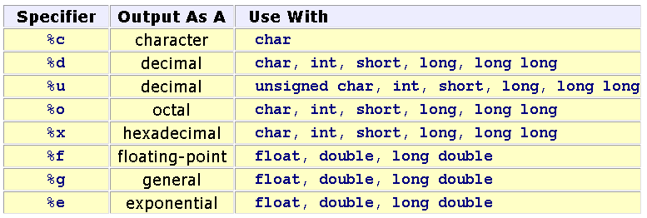
printf(…): Conversion Specifiers

Slide 47
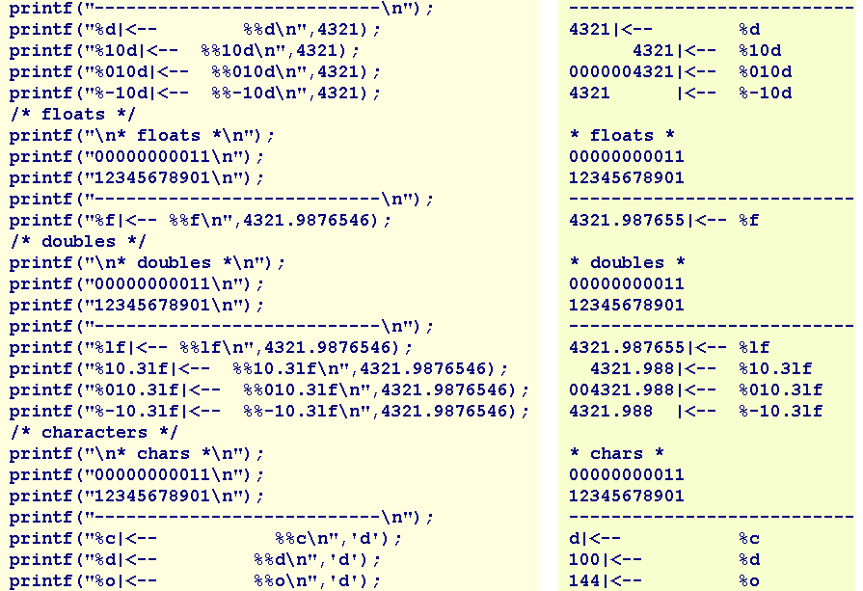
printf(…): Some Examples

Slide 48
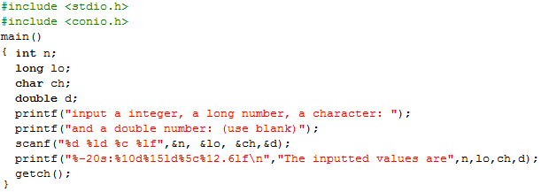
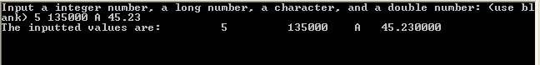
printf(…): Some Examples…
Size= 20
left align
Size=10
right
align
Size=15
right align
5
right
align
Size=12
including the
dot character,
right align

Slide 49
Summary
Formatted Output
putchar
printf
Q&A

Slide 50
Exercise
Write a C program using the following simple menu:
1- Processing date data
2- Character data
3- Quit
Choose an operation:
When user chooses 1: User will enter values of date, month, year then the program will announce whether this date is valid or not.
-When user chooses 2: User will enter two characters, then the program will print out ASCII codes of characters between them using descending order. Examples: Input: ca
Output: c: 99, 63h
b: 98, 62h
a: 97, 61h

Slide 51
Exercise
Write a C program using the following simple menu:
1- Quadratic equation ( phương trình bậc 2)
2- Bank deposit problem
3- Quit
Choose an operation:
When user chooses 1: User will enter values describing a quadratic equation then the program will print out its solution if it exists.
When user chooses 2: User will enter his/her deposit ( a positive number), monthly rate ( a positive number but less than or equal to 0.1), number of months ( positive integer), then the program will print out his/her amount after this duration.

